Slide 1

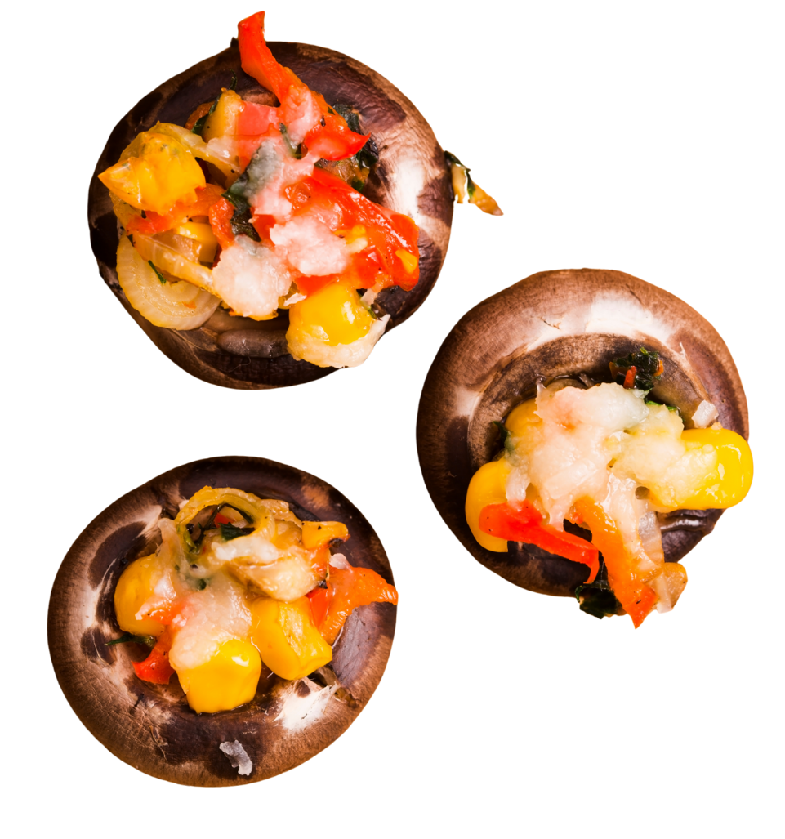

Fresh Mushroom Retail Performance
Period Ending November 2, 2025

Slide 2

Methodology
The report covers the four weeks ending November 2, 2025 with week endings:
  October 12, 2025
  October 19, 2025
  October 26, 2025
  November 2, 2025
Dollar references are the retail value, volume is reflected in pounds and units (packages)
Package size, organic, fixed/random weight and value-added all reflect the MULO+ expanded marketplace
For questions, contact Anne-Marie Roerink, at aroerink@210analytics.com
NOTE: As of the 11/5/2025 database restatement, new specialty mushroom aggregates for lion’s mane, trumpet, etc. are included in the database. Additionally, ongoing data cleaning efforts are underway. The restatement reflects more retailers as well as expanded market-level views.
Source: Circana, Integrated Fresh, MULO+, 4 weeks ending 11/2/2025

Slide 3
Four-year dollar sales trend
Dollar sales continued to contract in the latest quad-week period. Sales have declined
$110 million compared to three years ago in the 52-week view.
Source: Circana, Integrated Fresh, MULO+, 4 weeks and 52 w.e. 11/2/2025 versus same periods the past four years

Slide 4
Four-year unit sales trend
On an annual basis, unit sales have declined by about 52 million packages compared to
three years ago.
Source: Circana, Integrated Fresh, MULO+, 4 weeks and 52 w.e. ending 11/2/2025 versus same periods the past four years

Slide 5
Four-year volume (pound) sales trend
Pound sales also continue to contract. The quad-week is down by a little more than 2 million pounds.
Source: Circana, Integrated Fresh, MULO+, 4 weeks and 52 w.e. ending 11/2/2025 versus same periods the past four years

Slide 6
Mushroom contribution to produce sales
The mushroom share of fresh produce and total vegetables averages 3%-4%. Both have been trending down over the past few years.
4 weeks Mushroom $ share | Share of total produce | Share of total vegetables
3YA | 1.8% | 3.5%
2YA | 1.7% | 3.4%
YA | 1.6% | 3.3%
4 w.e. 11/2/2025 | 1.5% | 3.1%
52 weeks Mushroom $ share | Share of total produce | Share of total vegetables
3YA | 1.8% | 3.5%
2YA | 1.7% | 3.4%
YA | 1.6% | 3.3%
52 w.e. 11/2/2025 | 1.5% | 3.2%
Source: Circana, Integrated Fresh, MULO+, 4 weeks and 52 w.e. ending 11/2/2025

Slide 7
Mushrooms price per unit
Prices were mostly flat across total produce, total vegetable and mushrooms.
4 weeks Average price/unit | Total produce | Total vegetables | Mushrooms
3YA | $2.69 | $2.53 | $2.99
2YA | $2.77 | $2.50 | $2.96
YA | $2.80 | $2.50 | $3.02
4 w.e. 11/2/2025 | $2.79 | -0.3% | $2.52 | +0.6% | $3.05 | +0.9%
Source: Circana, Integrated Fresh, MULO+, 4 weeks ending 11/2/2025

Slide 8
Mushroom price per volume (pound)
On a per pound basis, mushroom prices declined, whereas vegetables increased 1.6%, the most in many weeks.
4-week Average price/pound | Total produce | Total vegetables | Mushrooms
3YA | $1.79 | $1.81 | $4.53
2YA | $1.82 | $1.77 | $4.49
YA | $1.83 | $1.76 | $4.55
4 w.e. 11/2/2025 | $1.81 | -0.9% | $1.75 | -0.5% | $4.54 | -0.3%
Source: Circana, Integrated Fresh, MULO+, 4 weeks ending 11/2/2025

Slide 9
Price per volume by quarter/month
The average mushroom price per pound is very similar to that seen in the fourth quarter of 2025.
Source: Circana, Integrated Fresh, MULO+, 2019-w.e. 11/2/2025

Slide 10
Price by type
4 w.e.11/2/2025 | Price per unit | % change vs. YA
Total mushrooms | $3.05 | +0.9%
White mushrooms | $2.68 | +1.6%
Crimini mushrooms | $3.39 | -0.1%
Portabella mushrooms | $2.57 | -0.8%
Specialty mushrooms | $5.98 | -1.6%
4 w.e. 11/2/2025 | Price per volume | % change vs. YA
Total mushrooms | $4.54 | -0.3%
White mushrooms | $4.00 | +0.7%
Crimini mushrooms | $4.53 | -1.7%
Portabella mushrooms | $5.18 | -0.1%
Specialty mushrooms | $13.34 | -3.7%
Specialty mushrooms include, shiitake, oyster, enoki, chanterelle, trumpet, lion’s mane, etc.
Source: Circana, Integrated Fresh, MULO+, 4 w.e. 11/2/2025

Slide 11

Mushroom dollar, unit, volume sales
A switch to larger pack sizes led to slightly lower declines in dollars and volume than units in the four-week period.
4 w.e. 11/2/2025 dollars
$107.6M
volume (lbs)
23.7M
-4.2%
-5.1%
-4.0%
Dollar
growth vs. YA
Unit
growth vs. YA
Volume
growth vs. YA
-8.8% vs. 3YA
-10.6% vs. 3YA
-8.9% vs. 3YA
Source: Circana, Integrated Fresh, MULO+, 4 weeks ending 11/2/2025

Slide 12
Vegetables and mushroom pound sales vs. YA
After trending down for many months, vegetable sales increased in October. However, this was largely driven by pumpkin sales versus core vegetables.
Source: Circana, Integrated Fresh, MULO+, 2020 -w.e. 11/2/2025

Slide 13
Share of dollars sold on merchandising
The quad-week showed very little activity, certainly compared with a few months ago.
Fresh mushrooms | 4 w.e. 11/2/2025 | Vs. YA | Latest 52 w.e. 11/2/2025 | Vs. YA
Share of dollars sold on promotion | 14.5% | -28.2% | 17.9% | -0.3%
* Any merchandising, including feature, display, feature & display and temporary price reductions
Source: Circana, Integrated Fresh, MULO+, latest 4 w.e. 11/2/2025

Slide 14
Over indexing versus under indexing regions
All regions struggled, but the Great Lakes got within one point of year-ago levels.
Use as comparison to understand importance/size of mushrooms
WEST
PLAINS
L-4 w.e. 11/2/2025 | Share of veg. lbs | Share of mushroom lbs | lbs sales growth vs. YA
Total US | 100.0% | 100.0% | -4.0%
California | 10.9% | 12.3% | -8.8%
Great Lakes | 14.1% | 15.1% | -0.8%
Mid-South | 13.4% | 12.2% | -3.2%
Northeast | 15.9% | 17.5% | -4.2%
Plains | 7.1% | 6.4% | -4.0%
South Central | 11.0% | 7.6% | -2.8%
Southeast | 14.4% | 14.7% | -5.9%
West | 13.2% | 14.3% | -1.7%
GREAT LAKES
NORTHEAST
MID SOUTH
CALIFORNIA
SOUTHEAST
SOUTH CENTRAL
= Above-average share vs. veg
= Better-than-average performance vs. total US
Source: Circana, Integrated Fresh, MULO+, L52 w.e. 11/2/2025 | Total fresh vegetables and total fresh mushrooms

Slide 15
Performance summary whites, browns and specialty
White mushrooms still make up the largest share of dollars but have fallen to 48.2%. Their volume share remains at 55%.
4 weeks ending 11/2/2025 | Dollars | Dollar share | $ sales vs. YA | $ sales vs. 3YA | Volume (lbs) | Lbs share | Lbs vs. YA | Lbs vs. 3YA
Total fresh mushrooms | $107.6M | 100.0% | -4.2% | -8.8% | 23.7M | 100.0% | -4.0% | -8.9%
White mushrooms | $51.9M | 48.2% | -5.3% | -13.0% | 13.0M | 54.7% | -5.9% | -13.4%
Crimini mushrooms | $39.4M | 36.6% | -2.0% | -6.1% | 8.7M | 36.7% | -0.3% | -2.2%
Portabella mushrooms | $7.0M | 6.5% | -8.9% | -18.9% | 1.4M | 5.7% | -8.9% | -15.3%
Specialty mushrooms | $9.3M | 8.6% | -4.0% | +20.2% | 0.7M | 2.9% | -0.4% | +22.1%
Source: Circana, Integrated Fresh, MULO+, 4 weeks ending 11/2/2025

Slide 16

Other insights
Packaged (fixed weight) versus random weight
Package-size analysis
Organic versus conventional
Value-added versus whole/uncut

Slide 17
Package size analysis
8-ounce packs drove the bulk of sales, but 24-ounce packages grew dollar, unit and volume sales in the past year. This was, in part, distribution driven.
Package size (per UPC) 52 weeks | Dollars | $ vs. YA | Units | % vs. YA | Volume | lbs vs. YA
8 OZ | $695.3M | -4.6% | 306.7M | -2.5% | 153.3M | -2.5%
16 OZ | $216.1M | -12.1% | 53.0M | -10.8% | 52.7M | -10.6%
24 OZ | $255.5M | +5.5% | 49.8M | +4.8% | 74.7M | +4.8%
Source: Circana, Integrated Fresh, MULO+, 52 weeks ending 11/2/2025

Slide 18
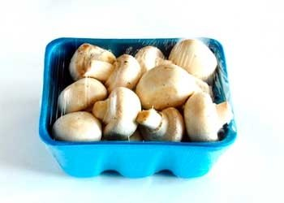
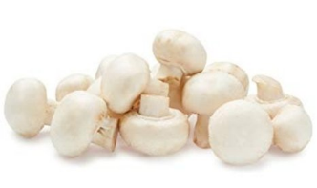
Packaged (fixed weight) versus random weight
Fixed-weight dollar sales outperformed random weight.
4 w.e. 11/2/2025 | Share of total mushroom sales and sales growth %
 | Fixed weight | Random weight
Dollar growth | -3.7% | -19.6%
Share of mushroom $ sales | 97.2% | 2.8%
Volume growth | -3.5% | -19.2%
Share of mushroom lbs sales | 97.4% | 2.6%
Source: Circana, Integrated Fresh, MULO+, 4 weeks ending 11/2/2025

Slide 19
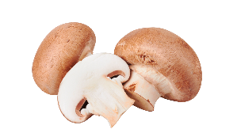
Organic versus conventional mushrooms sales
Organic mushroom sales dipped below year-ago levels.
4 w.e. 11/2/2025 | Share of total mushroom sales and sales growth %
Market
size
$83.2M
Dollar growth
-4.3%
Unit growth
-5.5%
Volume
growth
-4.0%
Conventional
Market size
$24.4M
Dollar growth
-4.2%
Unit growth
-3.0%
Volume
growth
-3.9%
Organic
Source: Circana, Integrated Fresh, MULO+, 4 weeks ending 11/2/2025

Slide 20
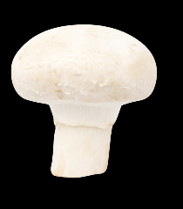

Value added versus whole mushrooms
Whole outperformed value-added mushrooms, though both areas were down. Value-added includes sliced, cut, stuffed, etc.
4 w.e. 11/2/2025 | Share of total mushroom sales and sales growth %
Market
size
$63.9M
Dollar growth
-3.3%
Unit growth
-4.5%
Volume
growth
-7.3%
Volume
growth
-2.8%
Whole
Market size
$43.8M
Dollar growth
-5.6%
Unit growth
-6.0%
Volume
growth
-5.8%
Value-
added
Source: Circana, Integrated Fresh, MULO+, 52 weeks ending 11/2/2025 compared with year ago

Slide 21
Questions?
For more information, contact the Mushroom Council: info@mushroomcouncil.org.

